Slide 1
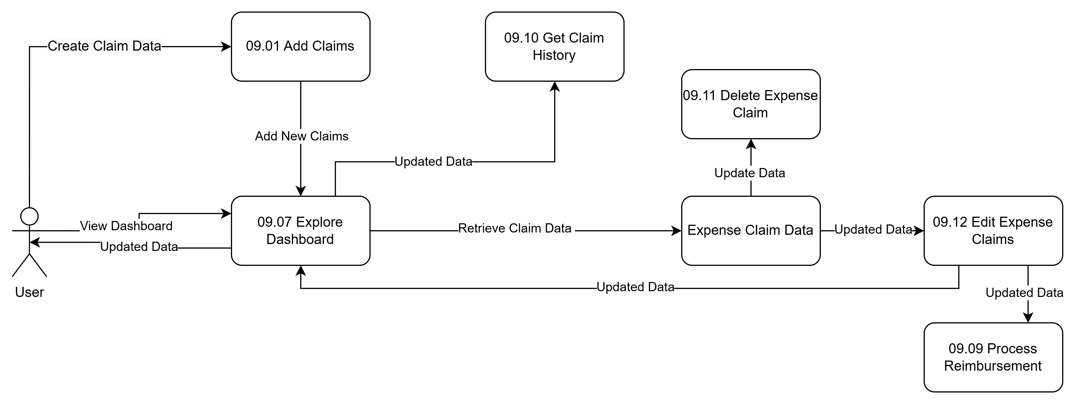
XERO APPLICATION
Data Flow Diagram(Logical) Expense Claim

Slide 2
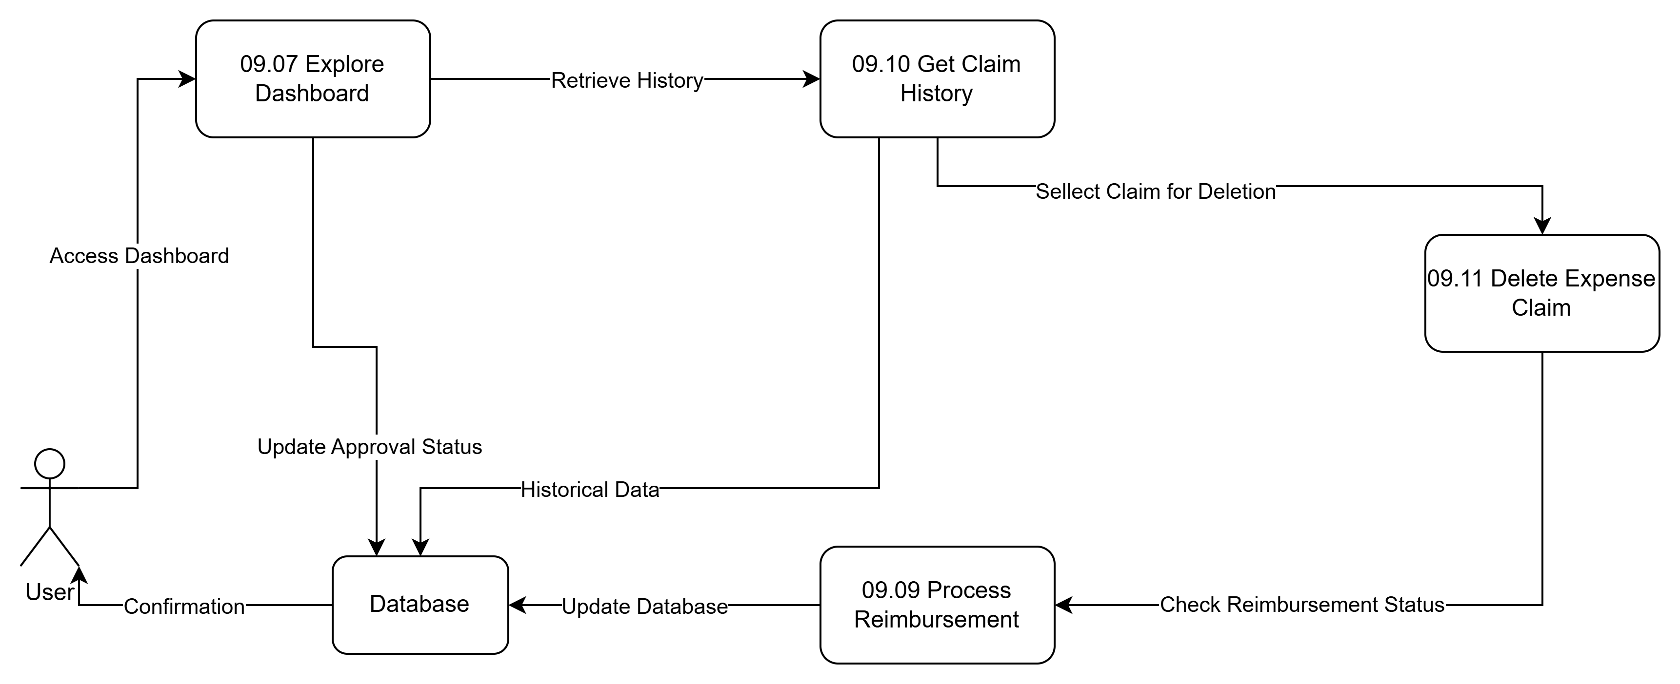
XERO APPLICATION
Data Flow Diagram(Logical) Delete Expense Claim

